Slide 1

REAL TIME RESEARCH PROJECT
THE HAPTIC INTERFACE SYSTEM FOR THE DISABLED INDIVIDUALS
D.RAMU 247R1A0579
MD ABUBAKAR 247R1A05A6
G.SURYAPRAKASH 247R1A0585

Slide 2
Contents:
Abstract
Introduction
Existing system and Limitations of existing system
Proposed system and Advantages of proposed system
Scope of work
System architecture
Novelty
Literature survey
work flow diagrams
References

Slide 3
Abstract
Haptic interface systems enable communication through touch-based feedback.
These systems help visually impaired, hearing impaired, and physically disabled individuals interact with digital environments.
The proposed system uses sensors, actuators, and microcontrollers to generate tactile signals.
The aim is to improve accessibility, independence, and human–computer interaction.
Applications include navigation assistance, communication devices, and learning tools.

Slide 4
Introduction
Disabled individuals face challenges when interacting with traditional computer systems.
Conventional interfaces depend heavily on vision and hearing.
Haptic technology uses touch sensations to convey information.
It converts digital signals into vibrations, forces, or motions.
This technology provides inclusive accessibility solutions.

Slide 5
Existing Systems
White Cane: A traditional mobility aid used by visually impaired individuals to detect obstacles through physical contact with the ground.
Guide Dogs: Specially trained dogs that assist visually impaired people in navigating obstacles and moving safely.
Electronic Obstacle Detection Devices: Some devices use sensors to detect obstacles and provide alerts through sound or vibration.
Audio-Based Navigation Systems: Certain assistive technologies use voice or audio signals to guide users during movement.
Smart Assistive Devices: Advanced systems use sensors and microcontrollers for obstacle detection, but they may be expensive or complex to use.

Slide 6
Limitations of Existing Systems
Limited Obstacle Detection: Traditional tools like white canes can only detect obstacles that are within physical reach and may not identify obstacles at a distance.
Dependence on Audio Alerts: Many electronic systems rely mainly on sound alerts, which may not be effective in noisy environments.
High Cost and Maintenance: Assistive technologies such as guide dogs and advanced smart devices require high cost, training, and maintenance.
Limited Functionality: Some existing systems only detect obstacles but do not provide additional features such as location tracking or wireless communication.
User Dependency: Many systems require continuous user effort or training, which may reduce convenience for some disabled individuals.

Slide 7
Proposed system
The proposed haptic interface system is designed as a wearable device that integrates ultrasonic sensors, IMU sensors, and a microcontroller to provide real-time tactile feedback.
The ultrasonic sensor measures the distance to nearby obstacles, while the IMU tracks hand orientation and movement. The microcontroller processes this data and activates multiple vibration motors arranged in an array to convey directional and distance-based information.
Bluetooth connectivity enables the system to connect to a smartphone application, allowing users to configure sensitivity levels, vibration patterns, and alert thresholds. The system is designed to be energy-efficient and lightweight, ensuring comfort during prolonged use. The modular architecture allows additional sensors and features to be integrated in the future.

Slide 8
Advantages of Proposed System
Real-Time Obstacle Detection: The system detects obstacles quickly using ultrasonic sensors and alerts the user immediately.
Wireless Communication: Uses ESP8266 modules to enable communication between transmitter and receiver units.
Location Tracking: The GPS module helps in tracking the user’s location when required.
Low Cost and Portable: The system is compact, lightweight, and uses affordable components, making it suitable for daily use.
Haptic Feedback: Provides vibration alerts through a vibration motor, allowing users to sense obstacles through touch.

Slide 9
DISADVANTAGES
Limited Sensor Accuracy: The ultrasonic sensor may produce inaccurate readings when objects have irregular surfaces or are positioned at sharp angles, which can affect obstacle detection reliability.
Limited Detection Range: The system can detect obstacles only within a specific distance range, which may not provide sufficient early warning in certain situations.
Dependence on Battery Power: Since the device operates using electronic components and wireless communication modules, continuous usage may lead to faster battery consumption.
Environmental Interference: External factors such as temperature changes, noise, or obstacles with soft surfaces may affect sensor performance.

Slide 10
Hardware Requirements
ESP8266 Microcontroller: Used as the main processing unit to control the system and handle wireless communication between transmitter and receiver modules.
Ultrasonic Sensor: Used to detect obstacles and measure the distance between the user and nearby objects.
R.P.S Module: Helps in identifying the position or reference location of the user.
GPS Module: Provides real-time location information which can be used for tracking and navigation purposes.
Push Button: Used for manual input or emergency alert activation.
Vibration Motor: Provides haptic feedback to the user through vibration signals when obstacles are detected.
Buzzer: Generates sound alerts to notify the user about detected obstacles or system warnings.
Power Supply / Battery: Supplies electrical power to the entire system for proper functioning.
Connecting Wires and Breadboard: Used to connect various electronic components during circuit implementation.

Slide 11
Software Requirements
Arduino IDE: Used for writing, compiling, and uploading code to the ESP8266 microcontroller.
Embedded C / Arduino Programming Language: Used to develop the program that controls sensor readings, data processing, and output alerts.
ESP8266 Libraries: Required to enable wireless communication and proper functioning of the ESP8266 module.
Serial Monitor: Used for debugging and monitoring system output during testing.
Mobile Application (Optional): Used to receive system data and monitor the device remotely.

Slide 12
NOVELTY
The novelty of this project lies in the development of a wearable haptic interface system that assists disabled individuals by converting environmental information into vibration-based feedback. The system uses sensors to detect obstacles and provides real-time alerts through a vibration motor and buzzer, helping users navigate their surroundings safely without relying completely on visual or audio cues.
Another unique aspect of the project is the integration of ultrasonic sensors, ESP8266 wireless communication, and GPS technology in a low-cost and compact design. This combination improves obstacle detection, enables location tracking, and allows efficient communication between system modules, making the device practical and useful for everyday mobility assistance.

Slide 13
System architecture
Input Sensors
↓
Microcontroller
↓
Signal Processing Unit
↓
Haptic Actuators (Vibration Motors)
↓
User Receives Touch Feedback

Slide 14
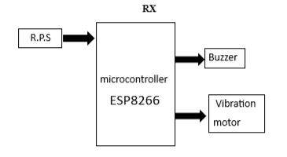
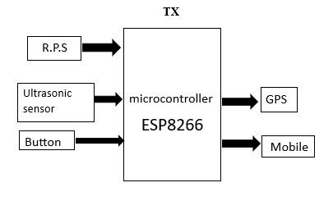

Slide 15
Modules Used
Obstacle Detection Module – Uses an ultrasonic sensor to detect nearby obstacles and measure distance.
Wireless Communication Module – Enables data transfer between transmitter and receiver using ESP8266.
Location Tracking Module – GPS module provides the user’s location information.
Processing Module – The ESP8266 microcontroller processes sensor data and controls the system.
Alert Module – Vibration motor and buzzer provide vibration and sound alerts to the user.
User Input Module – Push button is used for manual input or emergency activation.

Slide 16
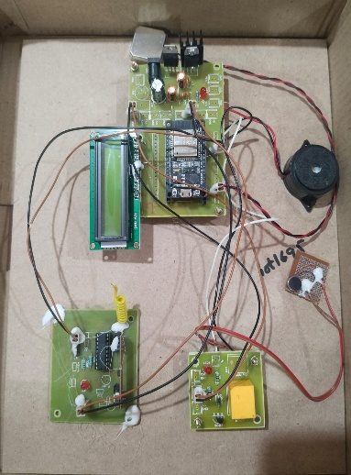
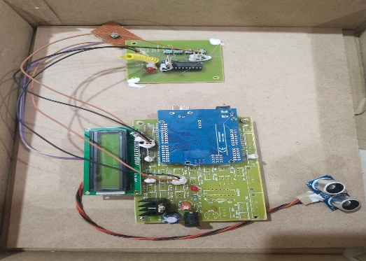
Prototype:

Slide 17
Scope of Work
Designing the hardware architecture
Developing haptic feedback mechanisms
Integrating microcontroller-based control
Testing usability with disabled individuals
Improving system efficiency and reliability
Future scope:
Integration with smartphones
AI-based navigation assistance
Advanced wearable haptic devices

Slide 18
Literature survey
AUTHORS | REVIEW | DESCRIPTION
Mandayam A. Srinivasan, Katherine J. Kuchenbecker | Haptic Interfaces for Visually Impaired Users: A Review | This paper provides a comprehensive review of haptic interface technologies developed to assist visually impaired individuals
Lynette A. Jones, Stephen J. Lederman | Design of Wearable Haptic Systems for Assistive Applications | The authors explore wearable haptic devices aimed at supporting individuals with sensory and motor disabilities.
Hiroshi Tanaka, Kenji Suzuki | Vibrotactile Feedback Systems for Navigation Assistance in Disabled Individuals | This study proposes a vibrotactile feedback-based navigation system designed for individuals with visual and mobility impairments.
Paolo Bonato, Hermano Igo Krebs | Haptic Feedback Interfaces for Rehabilitation and Assistive Technologies | This paper investigates the role of haptic interfaces in rehabilitation and assistive technologies for physically disabled individuals.
Jacob O. Wobbrock, Shaun K. Kane | Tactile Communication Systems for Assistive Human–Computer Interaction | The research focuses on tactile-based communication systems that enable disabled users to interact effectively with digital devices.

Slide 19
References
Human Haptic Perception, by Martin Grunwald, Birkhäuser Publishing, 2008.
Introduction to Autonomous Mobile Robots, by Roland Siegwart, Illah Nourbakhsh, and Davide Scaramuzza, MIT Press, 2011.
Designing for Interaction, by Dan Saffer, New Riders Publishing, 2010.
Arduino IDE Documentation – https://www.arduino.cc/reference
ESP8266 Arduino Core Documentation – https://arduino-esp8266.readthedocs.io
ESP8266 WiFi Module Technical Datasheet – Espressif Systems.
HCSR04 Ultrasonic Sensor Datasheet – Distance Measuring Sensor Module.
IEEE Digital Library – Research papers on Haptic Interfaces and Assistive Technologies.
World Health Organization reports on assistive technologies and disability support.

Slide 20
THANK
YOU

